Slide 1
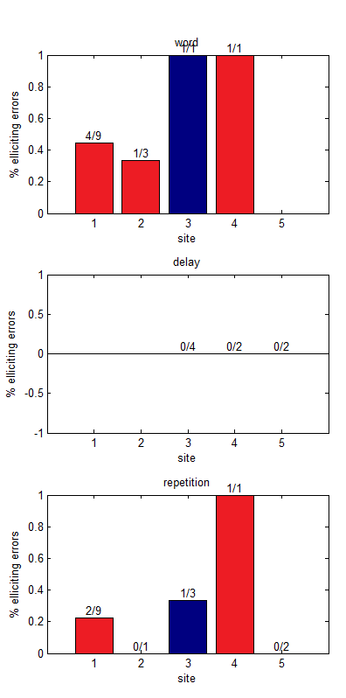
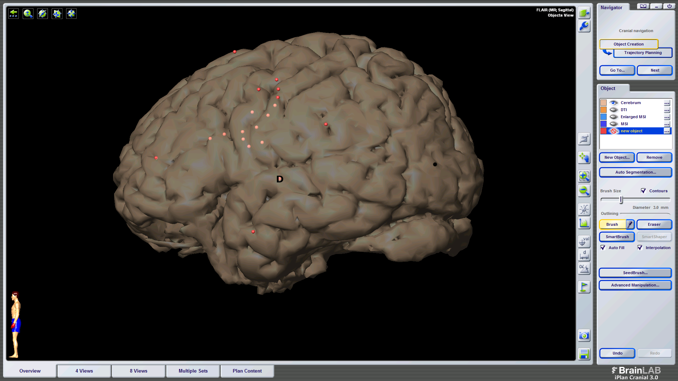
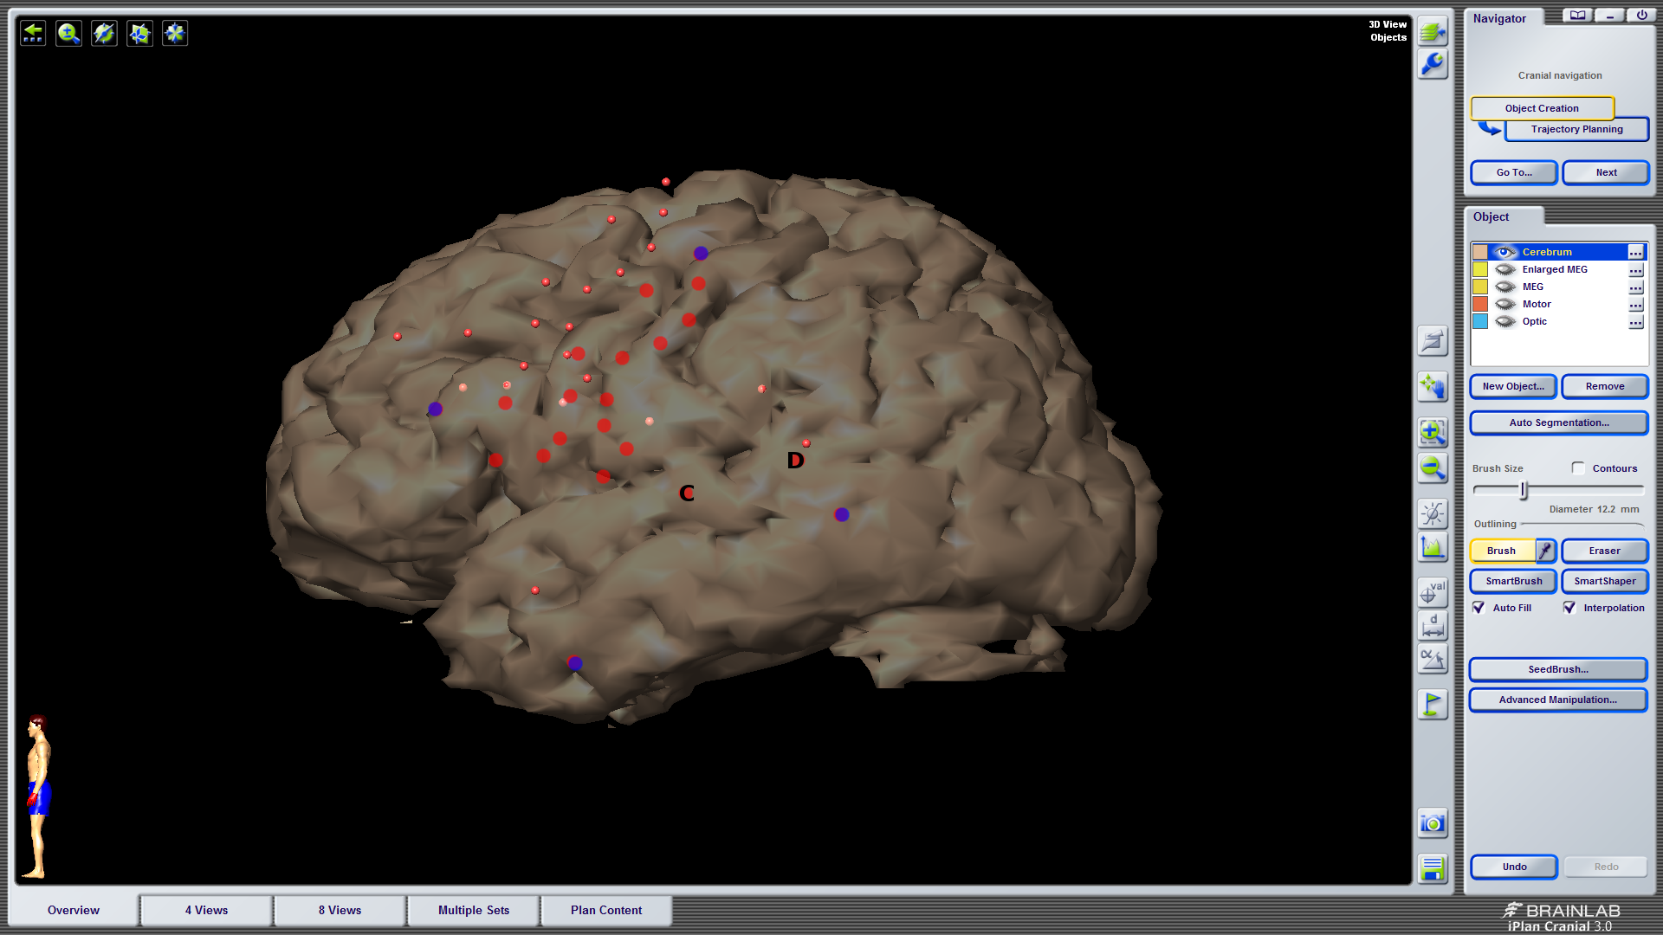
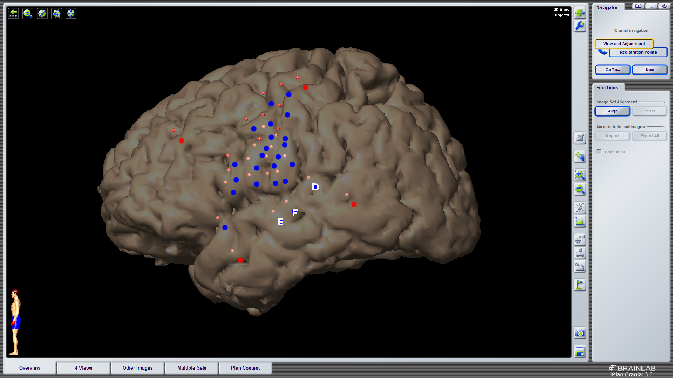
Stimulation error rates
mSTG
pSTG

Slide 2
EC22

Slide 3
EC22
9 trials w/ stimulation during target presentation only
a. 4/9 trials caused errors
a. 3 perceptual errors, "I didn't understand it", 1 real word substitution (native -> negative)
6 trials stimulation during buffer window only
a. no errors during buffer period
9 trials w/ stimulation during production window only (1 additional trial with partial stim during buffer)
a. 2/9 trials caused errors
a. classified as phonological errors. these were non-word responses that seemed to be affected by poor phonological selection or altered output during disrupted feedback (e.g, velocity -> velositivity; delivery -> deliverty...deliver...something like that)
Word: 4/9 (3 perceptual, 1 real word sub)
Delay: 0/0
Rep: 2/9 phonological error

Slide 4
147 1

Slide 6
EC23

Slide 7
EC23
Word: 1/1 perceptual error
Delay: 0/4
Rep: 1/3 Phonological error
SITE 'C'
3 trials w/ stimulation during target window only (2 additional trials w/ bleedover into buffer window)
a. 1/3 trials caused error (1 bleedover trial classified as an error)
a. error classified as perceptual (bleedover error classified as perceptual)
0 trials w/ stimulation during buffer window only
1 trial w/ stimulation during production window only (1 w/ partial stimulation during buffer window)
a. 0 errors (1 error during partial stimulation trial - classified as offset error)
SITE 'D'
1 trial w/ stimulation during target window only
a. 1/1 trials caused error - classified as perceptual error, "i don't know"
4 trials w/ stimulation during buffer window only (3 addition trials w/ bleedover)
a. 0/4 trials w/ error (1/3 trials w/ error - classified as offset error)
2 trials w/ stimulation during production window only
a. 1/2 trials w/ error - classified as phonological error
a. of note: the target was motive and the patient said "moutuh" and then self-corrected and said
"motive" at the stimulation offset
Word: 1/3 perceptual error
Delay: 0/0
Rep: 0/1 error

Slide 8
mSTG

Slide 9
pSTG

Slide 10
Corr >.28 (top 95%) p>0.05 to mean chan30 WO 1-800

Slide 11
Corr >.59 (top 95%) p>0.05 to chan102 WO 1-800 (single trial corr)

Slide 12
Corr >.47(top 95%) p>0.05 to chan21 WO 1-800 (single trial corr)

Slide 13
Corr >.27(top 95%) p>0.05 to chan30 Beep 1-800 (single trial corr)

Slide 15
WO long vs short

Slide 16
B long vs short

Slide 17
RO

Slide 18
All Events

Slide 19
EC24

Slide 20
EC24
Word: 0/0
Delay: 0/2
Rep: 0/2
SITES 'E' & 'F' collapsed
1 trial w/ stimulation during target window only (1 trial w/ bleedover into buffer)
a. 1/1 trial caused error - classified as phonological, velocity -> muhgrasity (no error on bleedover trial)
2 trials w/ stimulation during buffer window only (1 trial w/ bleedover)
a. 0/2 trials caused error (no error during bleedover trial)
1 trial w/ stimulation during production window only
a. 1/1 trial caused error - classified as phonological, statistical -> suhdastruh
SITE 'D'
0 trials w/ stimulation during target window only
a. no errors
2 trials w/ stimulation during buffer window only
a. no errors
2 trials w/ stimulation during production window only (1 w/ partial stim during buffer window)
a. no errors
OF NOTE: this patient was very tearful throughout the procedure (labiality and pain seemed to be stimulation-related, perhaps given site of tumor location); there was no epilepsy team and during the probe list the patient stated that he felt an "aura", so he most likely was having a seizure and it may question some of his results during both sets of repetition data
Word: 1/1 phonological error
Delay: 0/2 error
Rep: 1/1 phonological error

Slide 21
53 4

Slide 22
54 4

Slide 23
52 4

Slide 24
147 5

Slide 25
131 5

Slide 26
115 5

Slide 27
116 5

